Slide 1
Sales Dataset Analysis – Advanced Excel Project
Nanthini Hariraman
23-06-2025
DA DS & May batch

Slide 2
Project Overview & Objectives
Project Overview:
To explore, analyze and derive meaningful insights from sales data and using advanced Excel Tools and Techniques
Key Objectives:
Identify trends and patterns in sales
Evaluate Product and Channel Performance
Find the effects of returns and discounts
Build an interactive and user-friendly dashboard

Slide 3
Data Description and Preparation
Dataset Descriptions:
Superstore Sales dataset with around10000 rows; 21 Columns like Row ID, Order ID, Order Date, Ship Mode, Customer Details, Product Details and Sales and Discount Details.
Preparation:
Formatted Table structure
Formatted date and currency formats
Checked for Duplicates and Missing Values

Slide 4
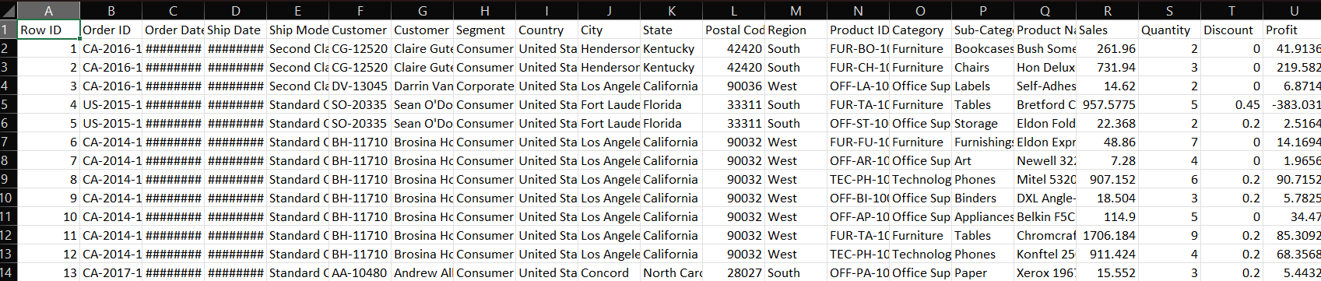
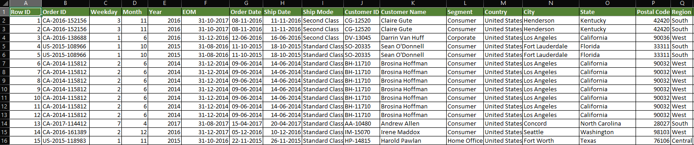
Visuals:
RAW DATA
CLEANED DATA

Slide 5
Key Metrics Calculation and Data Analysis
Key Sales Metrics:
Metrics like total sales,average sales, discount %, etc.
These help evaluate profitability and customer behavior.
Excel Formulas Used:
SUM() – Total Sales
AVERAGEIF – Avg. Sales per order
COUNTIF – Count based on category

Slide 6
Pivot Tables and Pivot Charts
Pivot Table:
Pivot table is used to quickly summarize and compare data based on categories like Sales Channel, Product Category.
Charts Used:
Bar Chart : Quantity wise segment
Line Chart : Sales based on Month
Pie Chart : Orders By Category

Slide 7
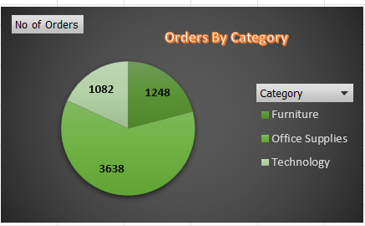
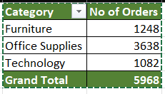
Pivot Table and chart

Slide 8
Dashboard Overview
Dashboard is used to provide a real-time ,and user-friendly overview of key metrics.
KPIs :
Total Sales, Total Discount, Best selling product, and Average Sales.
Interactive Elements :
Slicers for region, Product type and Month.

Slide 9
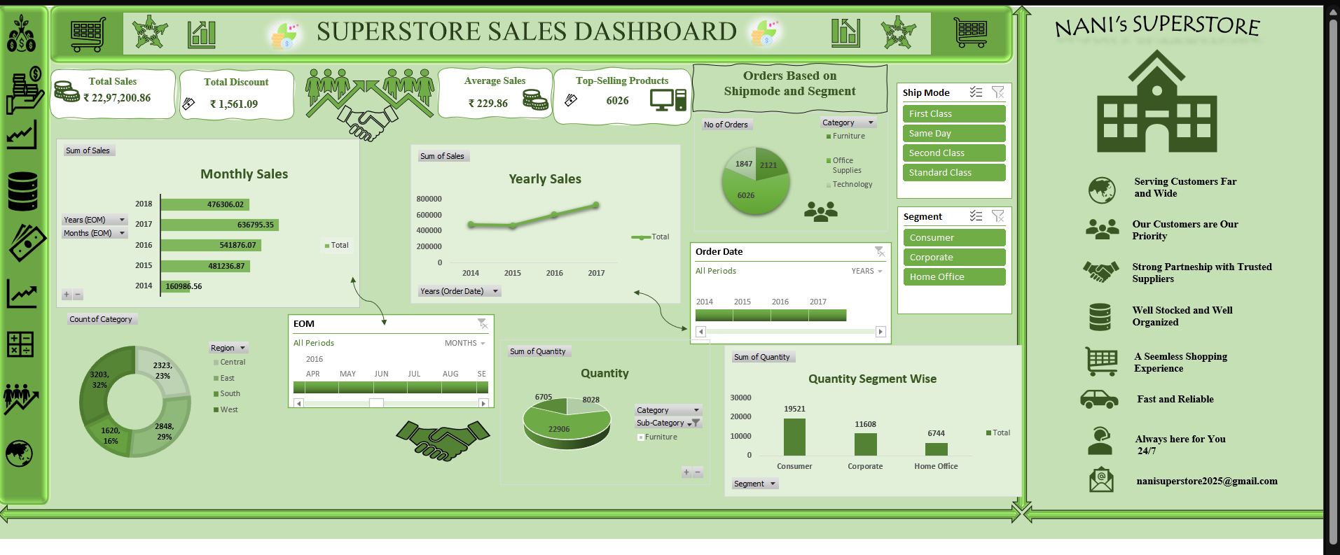
DASHBOARD VIEW

Slide 10
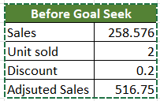
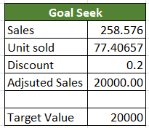
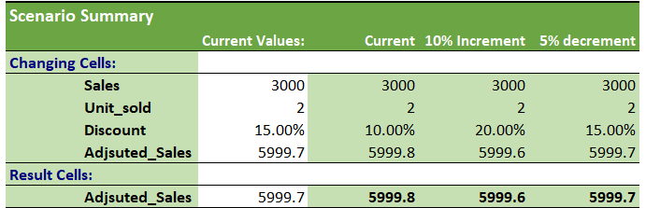
What-If Analysis & Goal Seek
After
Goal Seek :
An Excel tool to find the input needed to reach a desired result.
E.g., calculate units needed to hit a target revenue.
Scenario Analysis :
Testing different inputs (e.g., Sales Value, based on Discount change) to see their impact.
Helps understand possible future outcomes.

Slide 11
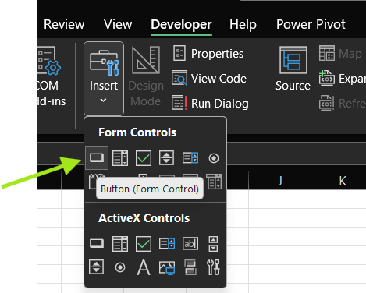
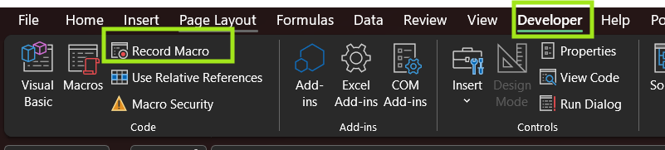
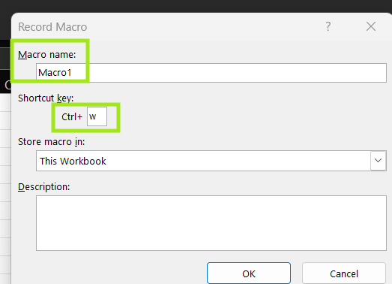
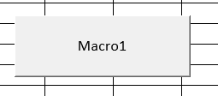
Macros and Automation
Macro:
A recorded set of actions in Excel that is used to automates repetitive tasks like formatting, calculations, or report updates.

Slide 12
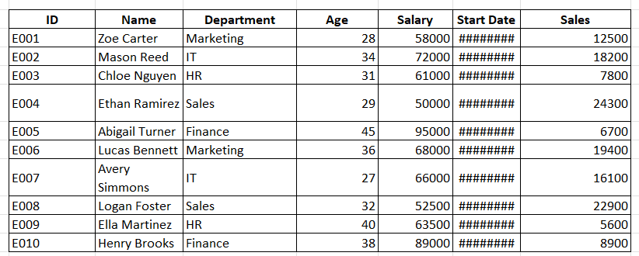
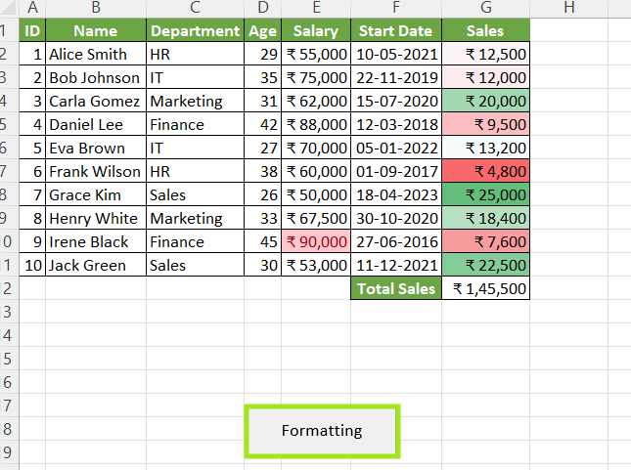
Raw Dataset
Changes made while Macro recording an Copied to another

Slide 13
Insights and Recommendations
Insights:
Overall Sales Are Strong
Sales Are Increasing Every Year
Standard Shipping Is Most Popular
Consumer Segment Buys the Most
Office Supplies Products Sell Best
West Region Has the Highest Sales
Recommendations :
Promote Standard Shipping Benefits
Focus on Top Categories
Encourage Corporate and Home Office Buyers
Improve Sales in the South Region
Plan Discounts Smart

Slide 14
Conclusion
In this project, we used advanced Excel techniques to analyze a comprehensive sales dataset.
By calculating key metrics, visualizing trends with PivotTables and charts, and creating an interactive dashboard, we were able to uncover valuable business insights.
Tools like Goal Seek, What-If Analysis, and Macros helped us explore different scenarios and automate repetitive tasks, increasing efficiency.
Overall, the project demonstrated how Excel can be a powerful tool for data analysis and decision-making in a business environment.

Slide 15

THANKYOU !!

